Slide 1
SkIll &
Human Identity
Some bad news, some good
Notes:
I want to talk about the reality of AI in the very broadest terms. Two thing in particular.
There’s no point talking about strategies for education without first grasping the generality and depth of these problems. So I’ll start with them, and then move to educational strategies.

Slide 2
First,
The bad news
(& the big picture)

Slide 3
AI is already SMARTER THAN US
It will Change what it means to be human

Slide 4
AI is already SMARTER THAN US
It will Change what it means to be human
Educational strategies

Slide 5
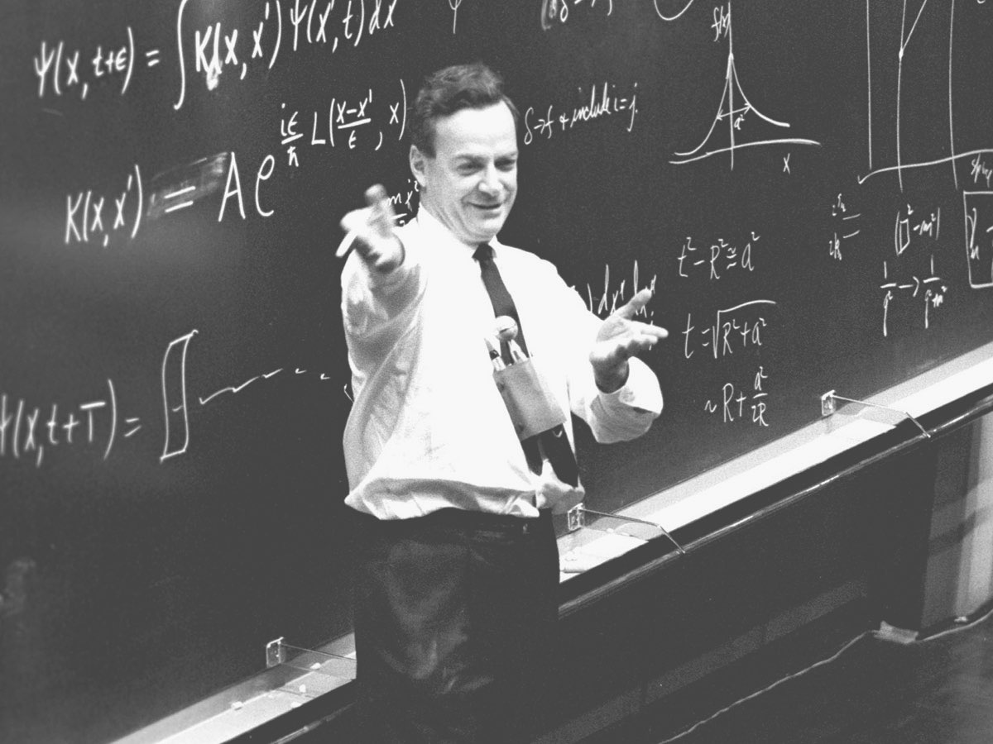

?
?
?
Notes:
he’s still not gonna have any idea what’s going on.

Slide 6
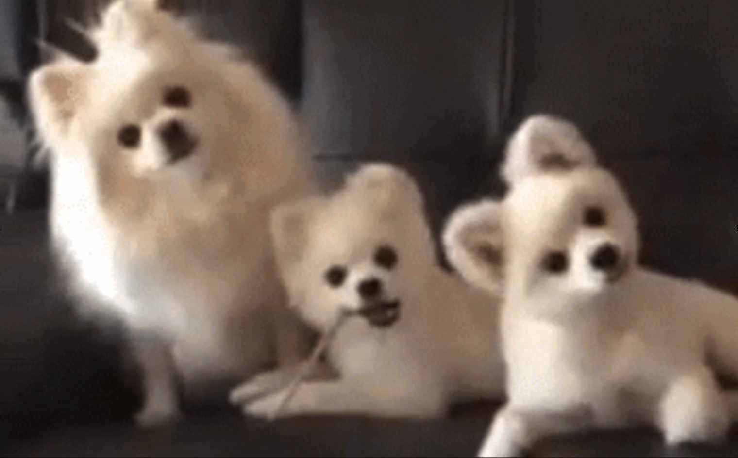
?
?
?
Notes:
AI already understands the world in ways we just don’t have the cognitive capacities for.

Slide 7
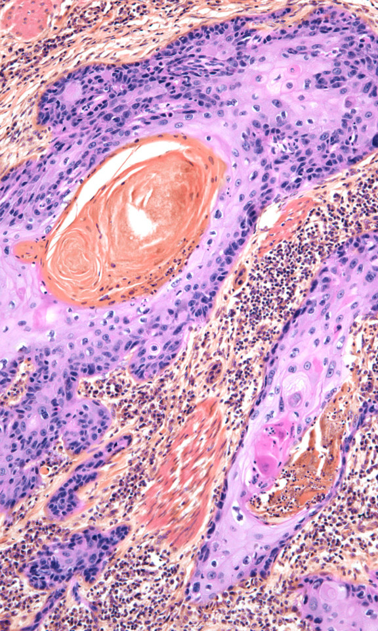
?
?
?
INPUT
OUTPUT
Is it
CANCER?
Stand-Alone Artificial Intelligence for Breast Cancer Detection in Mammography: Comparison With 101 Radiologists. JNCI: Journal of the National Cancer Institute, 2019

Slide 8
?
?
?
AI will
meet goals
at superhuman levels
DATA + GOALS
INPUT
OUTPUT
Notes:
Not only will we not need truck drivers, we won't need programmers.

Slide 9
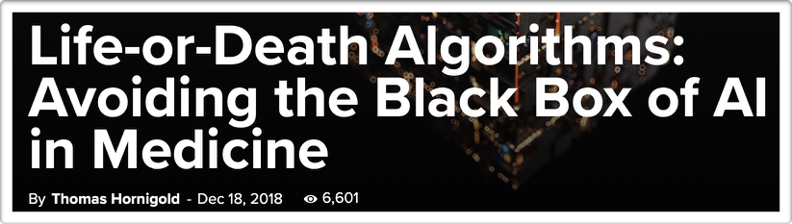
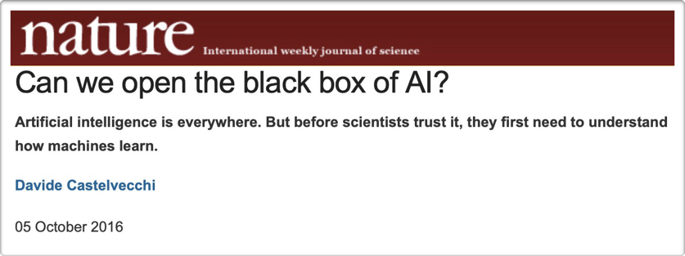
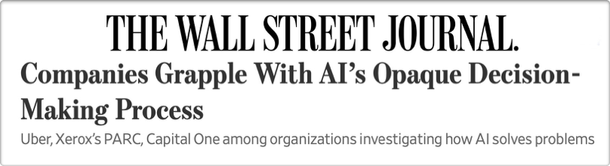

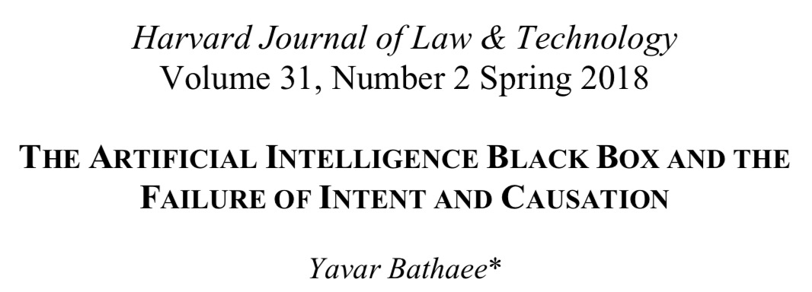
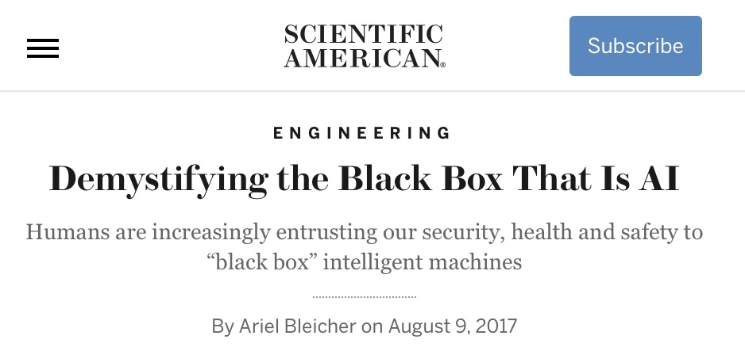

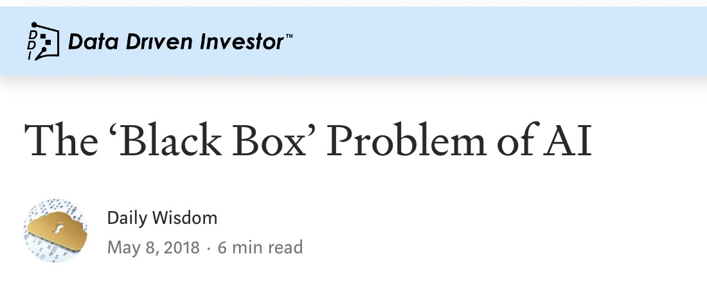
Notes:
I want to clarify what than means to us, as a species.

Slide 10

?
>
?
?
?
>
?
?
Notes:
OPAQUE

Slide 11
CAPACITIES
ARTIFICIAL INTELLIGENCE
HUMANS
CATS
WORMS

Slide 12
AI is already SMARTER THAN US (as a Species!)
It will Change what it means to be human

Slide 13
UNIQUE, SUPERLATIVE & SELF-SUFFICIENT TRAITS
OUR IDENTITY AS "HUMAN"

Slide 14
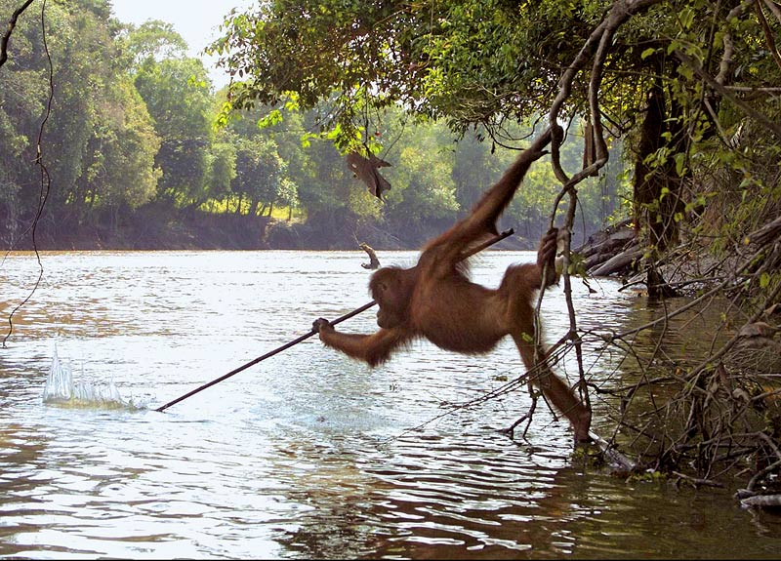
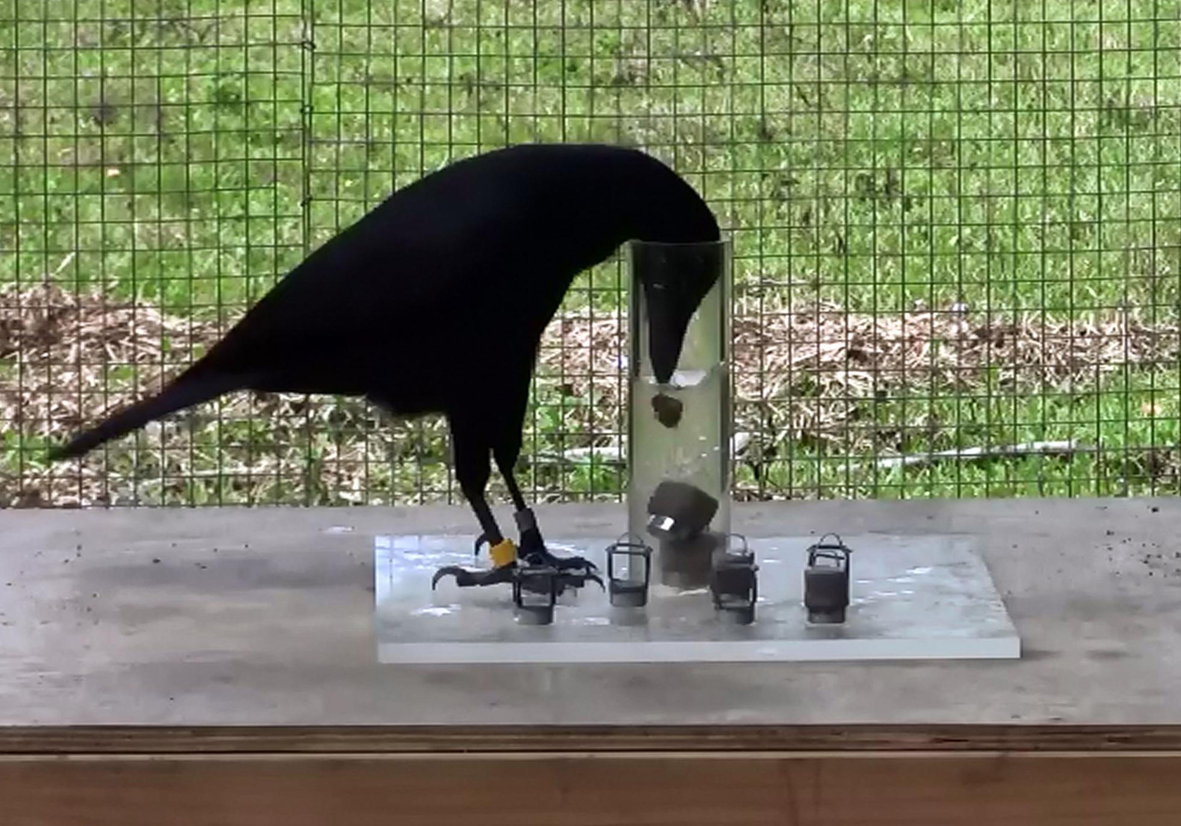

Slide 15
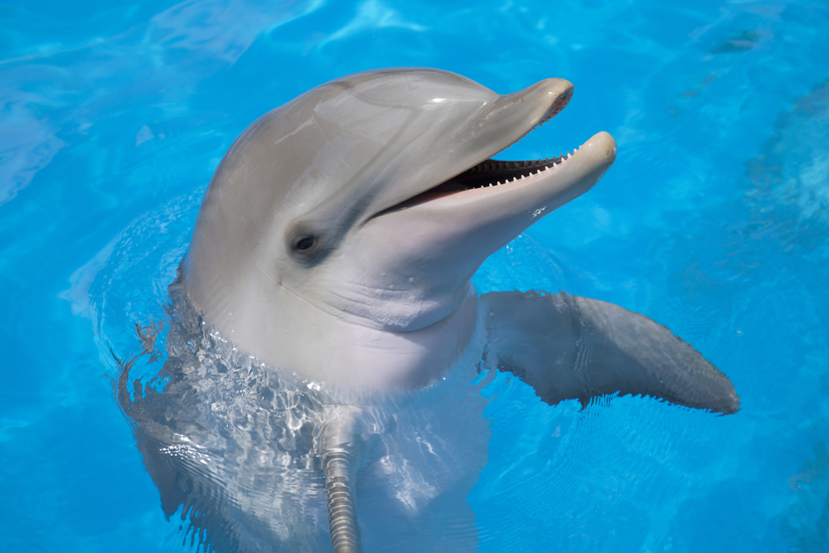
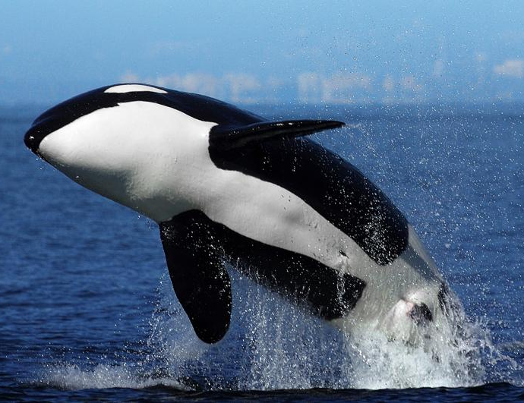
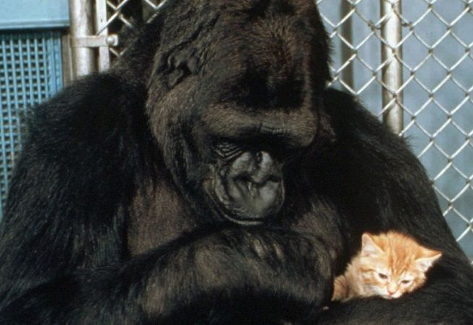

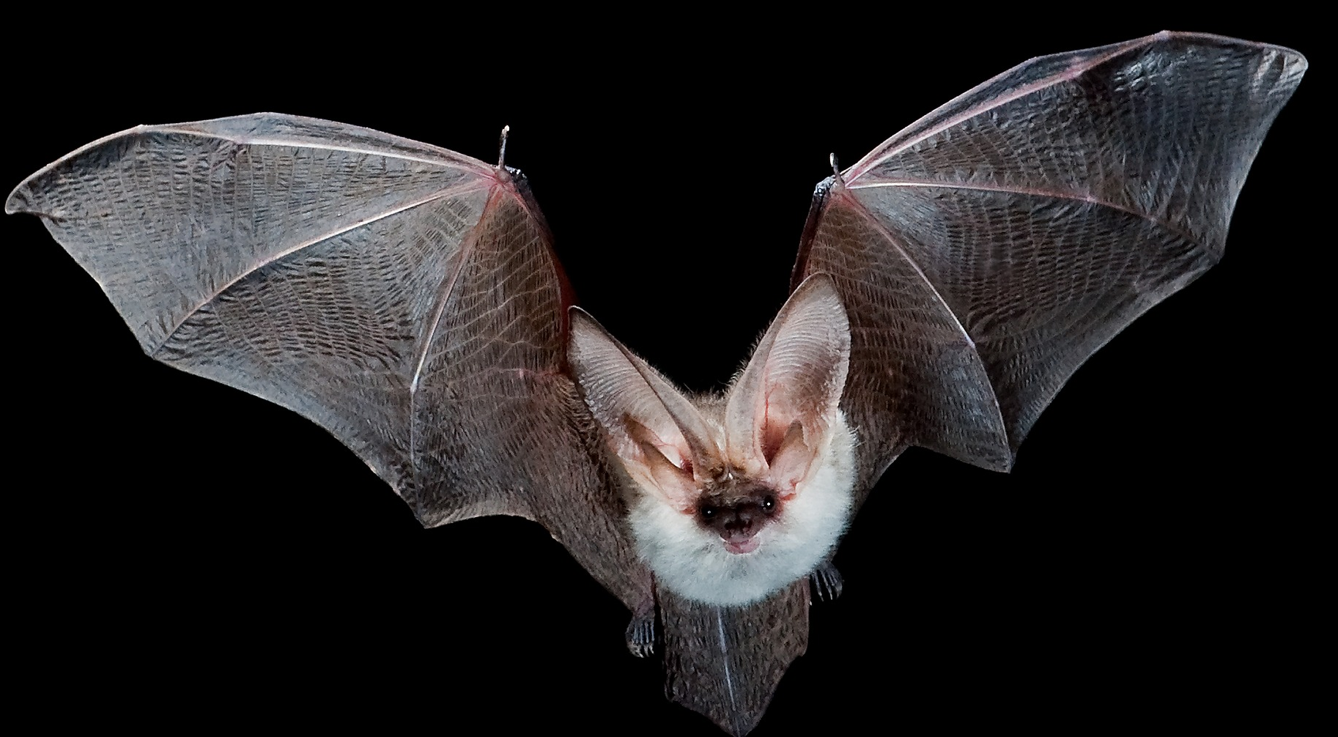
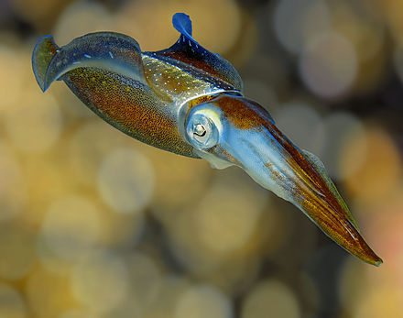
Other examples: abstract symbolic thinking, self-analysis, freewill, geocentrism, evolution, etc.
Notes:
Symblic thinking, place in universe.

Slide 16
No ability will be unique to us
None will be superlative with us
& the ones we can’t understand

Slide 17
UNIQUE, SUPERLATIVE & SELF-SUFFICIENT TRAITS
?
OUR IDENTITY AS "HUMAN"

Slide 18
The question of education runs deep. How do WE prepare for a future where:
Every ability is replaced
The experience of being human is itself different

Slide 19
The good news
(how to teach
For the future)

Slide 20
1.
Transcend First-Order Skills

Slide 21
First order skills: programming, diagnosing depression, modelling protein folding, analyzing marketing data, designing machinery, OR Any Problem-Solving where the solution parameters are known! (If there’s an easy way to grade it, a machine can learn it)

Slide 22
Most problem-Solving is like this!
Notes:
Anything less than that will

Slide 23
Not problem-solving BUT problem-articulation
by teaching how to recognize misalignments in values, information, precedents, & prospects (GO Humanists!)
Notes:
Humanists are sometimes blamed for finding problems where there aren’t any (and having vague grading standards). But that’s because we’re very good at this. That’s the sort of thinking that should be central across the curriculum.

Slide 24
2.
Help students cope with the transition to a new “humanity”

Slide 25
Disability studies Is already working on this BY
ABILITY
IDENTITY
ASSISSTIVE TECHNOLOGIES

Slide 26
DSM-V:
… disability involves impairments… [in] how well an individual copes with everyday tasks:
• [Includes] skills in language, reading, writing, … knowledge, and memory.
• self-management in areas such as personal care…, money management… and organizing school and work tasks.
Notes:
How many of you use spell check? How many can recite your first cousin’s phone number? How may use a digital calendar or to-do list to keep track of tasks and reminders? Now imagine a world where everything is done w/ assistive technologies, where all of us are permanently reliant. Self-driving car / wheelchair
Google translate / braille reader

Slide 27
What do you use for everyday tasks?
Spellcheck
iPhone/Android
Outlook Calendar
GPS
Text-search
Braille Reader
Voice Generator
Wheelchair
Prostheses
Notes:
How many of you use spell check? How many can recite your first cousin’s phone number? How may use a digital calendar or to-do list to keep track of tasks and reminders? Now imagine a world where everything is done w/ assistive technologies, where all of us are permanently reliant. Self-driving car / wheelchair
Google translate / braille reader

Slide 28
What happens when every ability is delegated to machines? (When we are permanently and inextricably reliant on Assistive technology)
Notes:
As AI challenges our collective image as a superlative/autonomous species, and it certainly challenges the idea that some of us are more (or less) abled because we don’t (or do) use assistive technologies. Disability studies is

Slide 29
What happens When every ability is delegated to machines? (When we are permanently and inextricably reliant on assistive technology) Who is Self-sufficient? Who is abled/disabled? (etc.)
Notes:
These are the sorts of questions that DS is already attacking, by for example, SLIDE separating self-worth form self-sufficiency, and even calling into question the concept of self-sufficiency itself.

Slide 30
What happens When every ability is delegated to machines? (When we are permanently and inextricably reliant!) DS Already separating self-worth from self-sufficiency

Slide 31

Disability studies should be a cornerstone of the curriculum
Notes:
Some student may not how it’s directly relevant to them, but by planting these seeds in their mind, we’ll prepare them not only for tomorrow and the next day, but the deep AI future.

Slide 32
Thank you
Image Sources
http://live.iop-pp01.agh.sleek.net
https://figshare.com/articles/The_Foraging_Ecology_of_the_Mountain_Long_Eared_Bat_Plecotus_macrobullaris_Revealed_with_DNA_Mini_Barcodes/125967
http://YA-webdesign
https://www.dolphinaris.com/everything-you-need-to-know-about-dolphins/
https://kids.nationalgeographic.com/animals/orca/
https://www.theguardian.com/technology/2018/jun/10/artificial-intelligence-cancer-detectors-the-five
https://incrediblevanishingpaperweight.wordpress.com/2015/01/22/an-open-letter-to-the-huffington-post/
https://en.wikipedia.org/wiki/Prairie_dog
https://primatology.net/2008/04/29/orangutan-photographed-using-tool-as-spear-to-fish/orangutan-tool-use-fishing/
http://zimdarsgen564s14.weebly.com/phylogeny.html

